Slide 1



InventaPOS
Smarter Retail Starts Here
01

Slide 2


Problem Statement
Small and medium-sized businesses (SMBs) face challenges in managing inventory, handling online and offline transactions, and integrating with accounting systems. Current POS solutions are often expensive, lack offline functionality, and offer limited intelligence for business insights, especially for businesses in emerging markets..
10

Slide 3

Solution
Build a smart POS system with seamless integration to:
Inventory management systems
E-commerce platforms
Accounting software
Ensure the system works both online and offline, with:
Offline transaction storage using SQLite
Automatic data syncing when internet connection is restored
Incorporate AI-powered insights, such as:
Low-stock warnings to prevent stockouts
Sales forecasting to help with better planning and decision-making
Help businesses operate more efficiently by centralizing sales, inventory, and financial management in one platform.
06

Slide 4

Product
Our POS system enables businesses to record sales, manage stock levels, generate insightful dashboards, and access AI-driven alerts like low-stock warnings. It also supports tiered subscriptions (freemium and premium), works offline using local SQLite storage, and syncs to a cloud server when online. It integrates with e-commerce platforms and accounting software for a holistic business solution.
04

Slide 5



Target Market
2 out 5
Elaborate on simple, affordable, and powerful solutions like ours.
95%
Businesses are SMEs backbone of emerging economies,
Over 123 million
Globally operate on SME’s businesses that represent a massive underserved market, making the demand for affordable and smart POS technology grow rapidly.
14

Slide 6
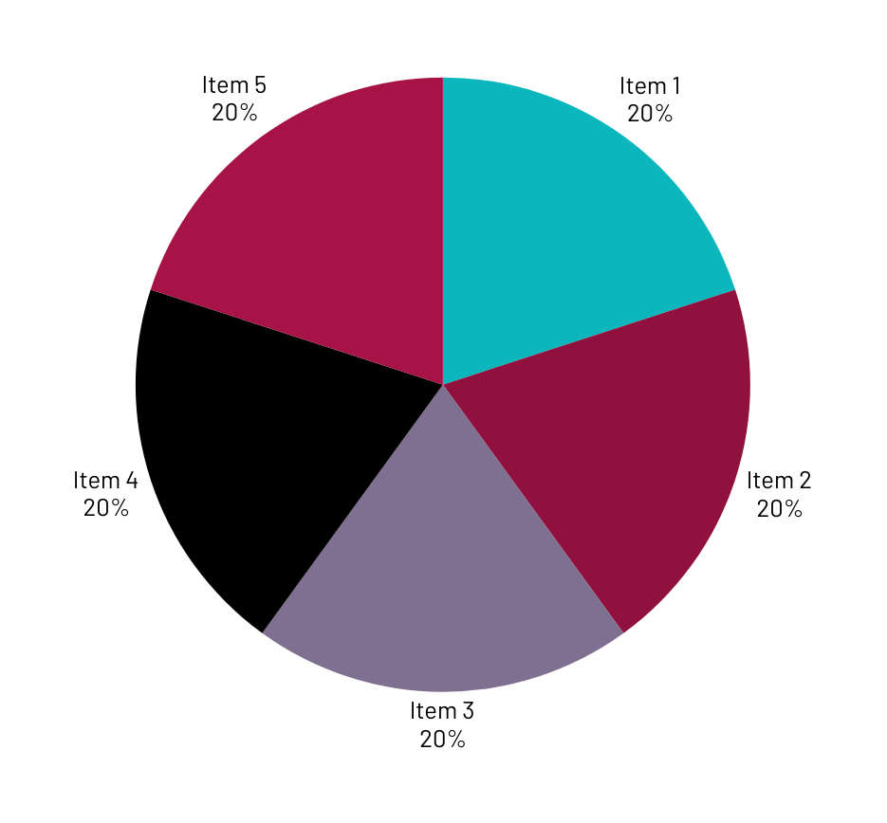
Market Size
The global POS market size was valued at approximately $80 billion in 2023 and is expected to reach over $150 billion by 2030. In emerging markets like Africa, Southeast Asia, and Latin America, retail digitization is accelerating, offering a multi-billion-dollar opportunity to serve SMBs transitioning from manual to digital systems.

Slide 7

Competitors
Competitors include Square POS, Shopify POS, Lightspeed, Toast POS, and local providers like Kopo Kopo (Africa). These solutions, however, often require constant internet access, are expensive, or offer limited offline functionality and AI capabilities.
23

Slide 8

Competitive Advantage
Our POS system offers true offline-first functionality with seamless syncing.
AI-powered insights, such as predictive low-stock alerts and sales forecasting.
Freemium access for startups and affordable tiered subscriptions.
We offer native e-commerce integration and accounting exports, features often missing in competing products for SMBs in emerging economies.

Slide 9
Project Traction
Tasks
Month 1
Month 2
Month 3
Month 4
Month 5
Project Research
Data Collection
Project Designing
MVP Development
MVP Testing
MVP Deployment
MVP Maintenance
Future Works
23

Slide 10

Our revenue model is subscription-based, offering a freemium tier with optional upgrades to premium features. We plan to charge monthly or annual fees for premium users, and offer add-ons such as custom analytics packages, priority support, and e-commerce store setup assistance.
Business Model
23

Slide 11
Go To Market
We plan to reach customers through targeted digital marketing (Google Ads, Facebook, and Instagram), partnerships with business associations, collaborations with local banks and microfinance institutions, and reseller programs for IT companies targeting SMEs. Early adopters will be engaged via a freemium campaign with easy upgrade paths

Slide 12
Social Impact
Decent work and Economic Growth - supporting small businesses to grow more efficiently.
Industry, innovation, and infrastructure - Encouraging technology adoption among SMEs.
Responsible Consumption and Production - Helping businesses manage inventory efficiency to reduce waste.
Partnerships for the goals - Collaborating with local entrepreneurs and financial institutions.

Slide 13
Our Ask
We are seeking $50,000 in seed funding to finalize product development, run pilot programs, and launch the initial marketing campaign.
The funds will be used as follows:
40% for product development (engineering, QA, and AI model tuning)
30% for marketing and customer acquisition
20% for operations and infrastructure (cloud hosting, server costs)
10% for legal, licensing, and administrative expenses.

Slide 14




Team Members
IRENE
KEVIN
JOAN
MATTHEW
Business Planner, Trainer
CTO
Project Manager
Project Research

Slide 15


Thank you!
Reach out for more:
Tel: +254 719524276 | Email: kvnkamaa@gmail.com
17

